Slide 1
Mini-project Presentation
Sub: LP-IV (Object Oriented Modeling and design)
UML Diagram for hotel management system

Slide 2
What are UML diagrams
UML, which stands for Unified Modeling Language, is a way to visually represent the architecture, design, and implementation of complex software systems.

Slide 3
Types
Structural UML diagrams
Structural UML diagrams, as the name would suggest, show how the system is structured, including the classes, objects, packages, components, etc. in the system and the relationships between those elements.
Behavioral UML diagrams
These UML diagrams visualize how the system behaves and interacts with itself and with users, other systems, and other entities.

Slide 4
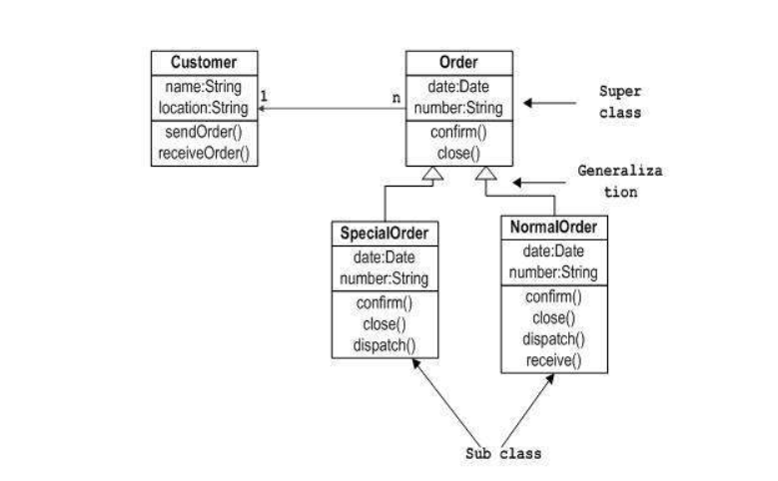
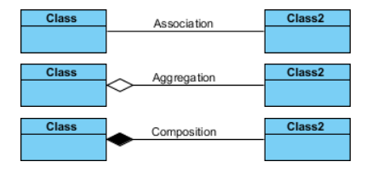
Class Diagram
Class diagram is a static diagram. It represents the static view of an application. Class diagram is not only used for visualizing, describing, and documenting different aspects of a system but also for constructing executable code of the software application.

Slide 5
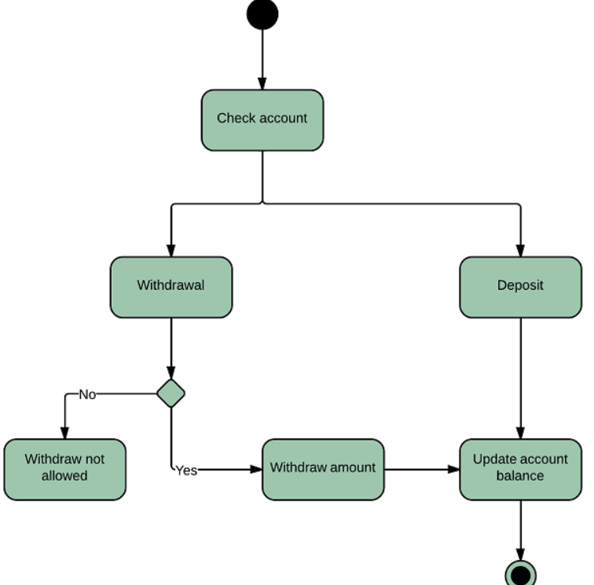
Activity Diagram
Activity diagram is another important diagram in UML to describe the dynamic aspects of the system.
Activity diagram is basically a flowchart to represent the flow from one activity to another activity. The activity can be described as an operation of the system.

Slide 6
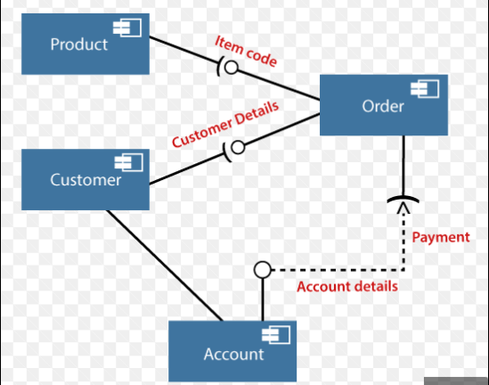
Component Diagram
Component diagrams are different in terms of nature and behavior. Component diagrams are used to model the physical aspects of a system. Now the question is, what are these physical aspects? Physical aspects are the elements such as executables, libraries, files, documents, etc. which reside in a node

Slide 7
Results

